Slide 1
BOOK-STORE
BY
VASANTH KUMAR D
SATHYAVELAKUMAR R
VIMAL D
ARAVINDHAN
AKASH DANEY AG

Slide 2
ABSTRACT
The Bookstore Project is an online platform designed to enhance the book purchasing experience through secure user registration and authentication. It features comprehensive book listings with detailed information, allowing users to filter selections by genre, author, and ratings. The streamlined purchase process enables users to add items to their cart and complete transactions securely, followed by an order confirmation that provides essential details. Additionally, users can access their order history to track shipments and review past purchases, creating a user-friendly environment for book enthusiasts.

Slide 3
INTRODUCTION
The Bookstore Project aims to enhance the online shopping experience for book lovers in a digital age where convenience is key. By addressing the limitations of existing platforms, our project focuses on secure user registration and authentication, detailed book listings, and advanced search and filtering options. We aim to streamline the purchase process and provide transparent order tracking, creating a user-friendly environment that fosters a community of readers and promotes a love for literature.

Slide 4
EXISTING SYSTEM
Limited User Authentication: Many platforms lack robust security measures for user registration and authentication, risking user data.
Basic Book Listings: Existing systems often provide minimal details about books, making it difficult for users to make informed choices.
Inadequate Search and Filtering: Users may struggle to find books that match their preferences due to limited search and filtering options.
Complicated Purchase Process: The checkout process can be cumbersome, leading to cart abandonment and a poor user experience.
No Order Tracking: Users often cannot easily track their orders or view their purchase history, leading to confusion.

Slide 5
PROPOSED SYSTEM
Enhanced User Authentication: Implementing secure registration and login processes to protect user information and ensure secure access.
Comprehensive Book Listings: Providing detailed book information, including title, author, genre, price, and availability, for better decision-making.
Advanced Search and Filtering: Allowing users to filter books by various criteria such as genre, author, ratings, and popularity for a more personalized experience.
Streamlined Purchase Process: A user-friendly checkout process that enables easy cart management and secure payment completion, reducing cart abandonment.
Order Tracking and History: Offering users the ability to view their order history and track shipments, enhancing transparency and user satisfaction.

Slide 6

MODEL
LOGIN PAGE

Slide 7
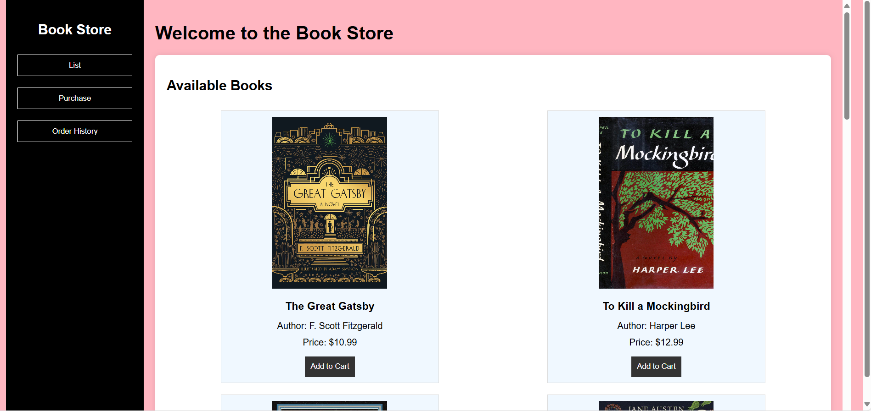
HOMEPAGE

Slide 8
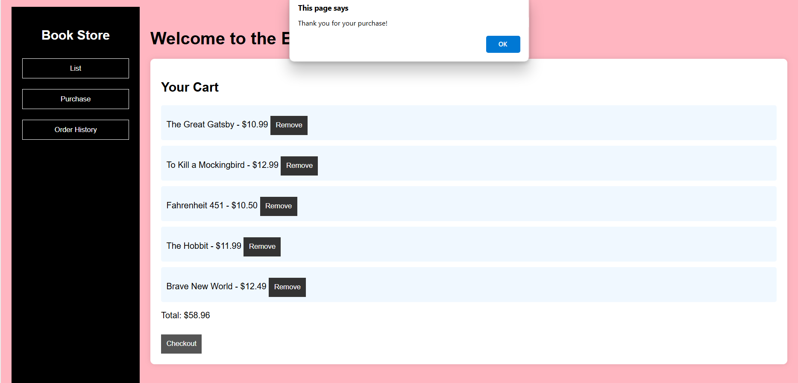
PURCHASE PAGE

Slide 9
CONCLUSION
The Bookstore Project represents a significant advancement in the online book shopping experience, addressing the shortcomings of existing platforms. By implementing secure user authentication, comprehensive book listings, and an intuitive purchasing process, we have created a system that prioritizes user satisfaction and engagement. The addition of order tracking and history enhances transparency, allowing users to feel connected to their purchases. As we move forward, our goal is to foster a vibrant community of readers while continually improving our platform to meet evolving user needs. With these enhancements, the Bookstore Project is poised to become a go-to destination for book enthusiasts.

Slide 10
THANK YOU

